Slide 1
Quantum Machine Learning
[Introduce to quantum ml – 2014]
Vu Tuan Hai

Slide 2
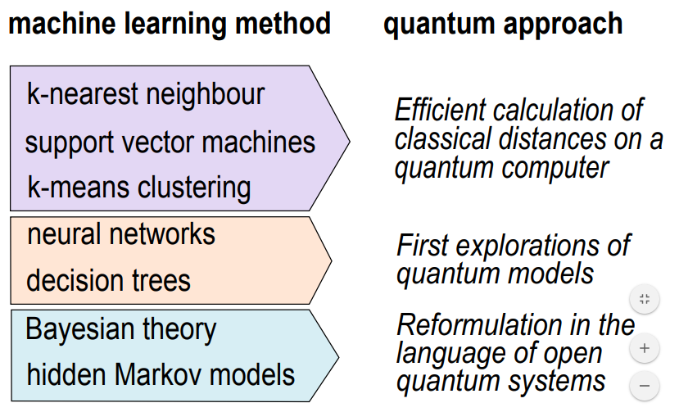

Slide 3
Quantum machine learning

Slide 4
1. Quantum computing

Slide 5
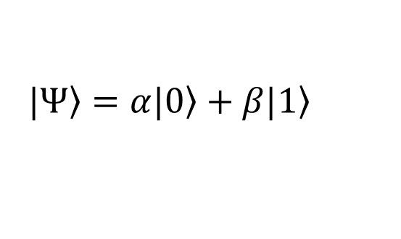
1.1. From single state to superposition
$$\left.|Ψ\right\rangle =α\left.|0\right\rangle +β\left.|1\right\rangle$$

Slide 6
1.2. From certainly to uncertainly
Certain Object: {
position: [],
momentum: []
}

Slide 7
1.3. Spooky action
A or B
A or B
entangled
open
100 % B
A

Slide 8
2. Quantum machine learning

Slide 9
Develop entire quantum algorithms to solve new problem

Slide 10

Using the advantages of quantum computing in order to improve machine learning algorithms
Quantum version of neural network (quanvolutional, …)
Speed up machine learning algorithms on quantum computer / simulation
Quantum learning

Slide 11

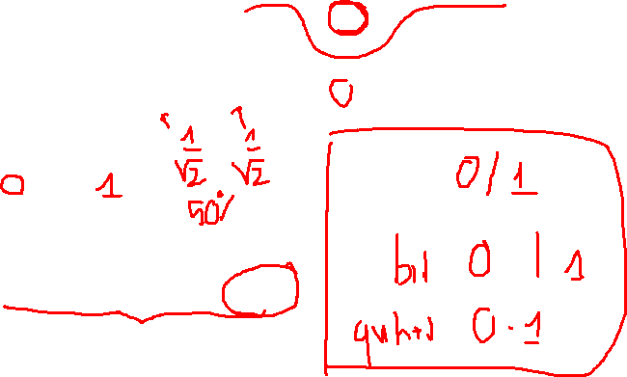
2.1. Qubit
Basic unit: $\left.|Ψ\right\rangle =α\left.|0\right\rangle +β\left.|1\right\rangle$, $α,β∈ℂ;\left.|0\right\rangle$, $\left.|1\right\rangle$ in 2-d Hibert space.
$${|α|}^{2}+{\left|β\right|}^{2}=1$$
$\left.|0\right\rangle =\left[\begin{matrix}1 \\ 0\end{matrix}\right]$, $\left.|1\right\rangle =\left[\begin{matrix}0 \\ 1\end{matrix}\right]$
Excute by ion trapping or photon.

Slide 12

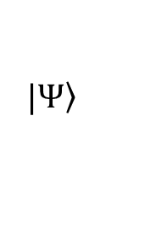
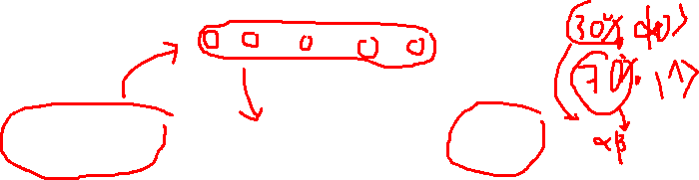
Classical data
00010000…
Quantum gates
Measure
$$\left.|Ψ\right\rangle$$
$$α, β$$
Classical computer

Slide 13
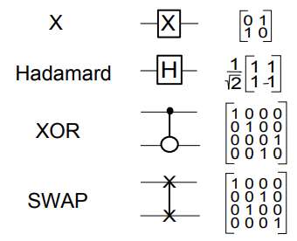
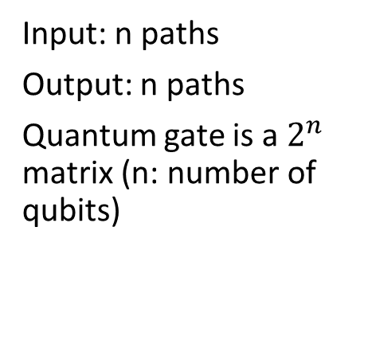
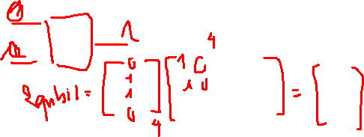
2.2. Quantum gate
Input: n paths
Output: n paths
Quantum gate is a $2^{n}$ matrix (n: number of qubits)

Slide 15
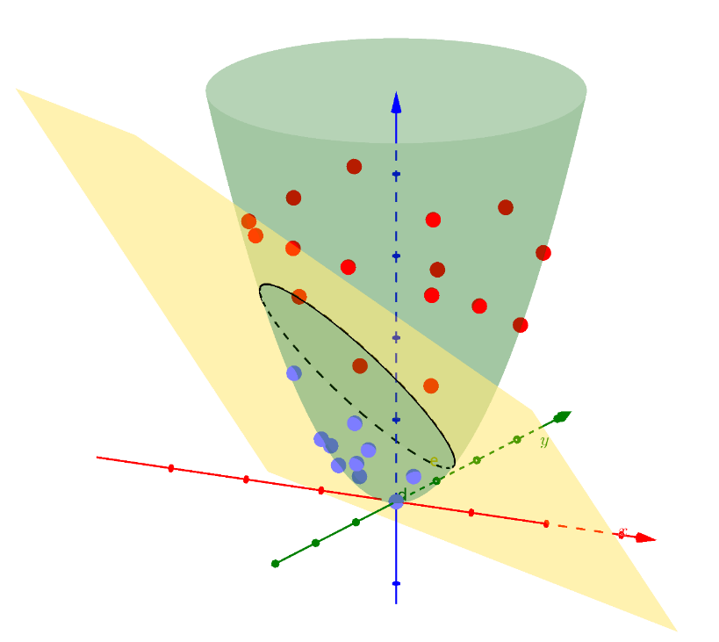
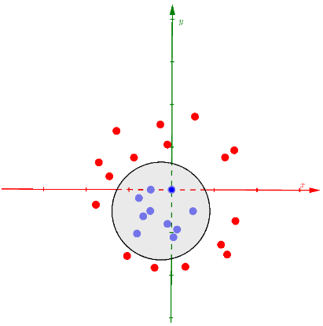


3. SVM version quantum
$$Φ()$$
$$\{\vec{x_{i}},y_{i}:\vec{x_{i}}∈R^{N},y_{i}∈{\left\{−1,1\right\}}_{i}\}=1…M$$

Slide 16
3.1. Steps
1. Mapping data non-linear to quantum state
2. (2.1) Use a variational circuit to generate hyperplane
(2.2) Use the quantum computer to estimate the kernel function of the quantum feature space directly

Slide 17

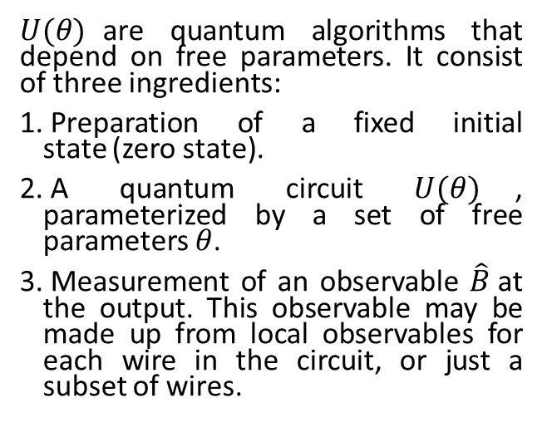

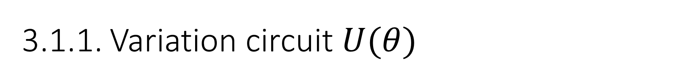
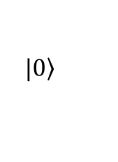
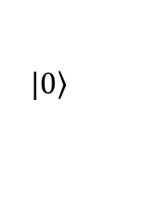

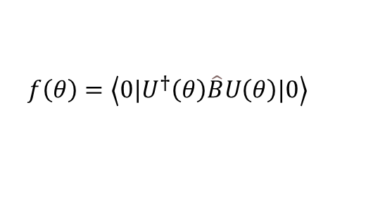

3.1.1. Variation circuit $U(θ)$
$U(θ)$are quantum algorithms that depend on free parameters. It consist of three ingredients:
Preparation of a fixed initial state (zero state).
A quantum circuit $U(θ)$, parameterized by a set of free parameters $θ$.
Measurement of an observable $\hat{B}$at the output. This observable may be made up from local observables for each wire in the circuit, or just a subset of wires.
$$f\left(θ\right)=\left\langle 0\left.|U^{†}\left(θ\right)\hat{B}U\left(θ\right)|0\right\rangle \right.$$
$$\left.|0\right\rangle$$
$$f\left(θ\right)$$
$$\left.|0\right\rangle$$
$$\left(θ\right)$$
$$tuned$$
$$cost$$

Slide 18
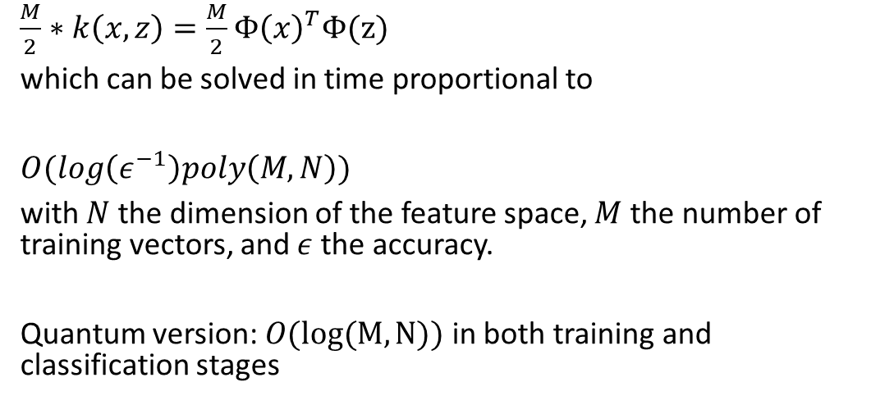
3.1.2. Problem when calculate kernel trick
$\frac{M}{2}∗k\left(x,z\right)=\frac{M}{2}Φ{\left(x\right)}^{T}Φ(z)$
which can be solved in time proportional to
$O(log\left(ε^{−1}\right)poly\left(M,N\right))$
with $N$ the dimension of the feature space, $M$ the number of training vectors, and $ε$ the accuracy.
Quantum version: $O(log⁡(M,N))$ in both training and classification stages

Slide 19

3.2. Quantum advantage
$$O(log⁡(M,N))$$
$$\text{Fast} \text{quantum} \text{evaluation} \text{of} \text{inner} \text{products}$$
Re-express the SVM as an approximate least-squares problem that allows for a quantum solution with the matrix inversion algorithm

Slide 20
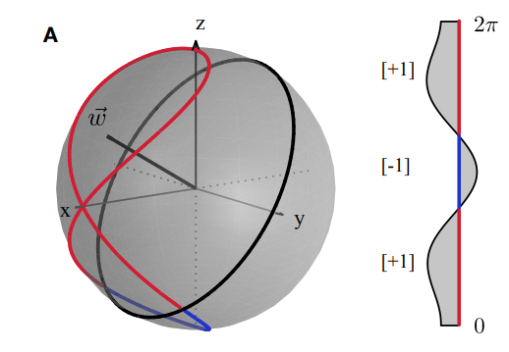
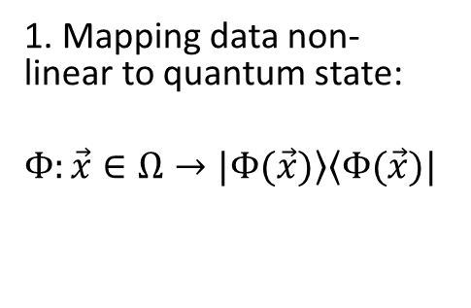


3.3. Mapping
Non-linear feature map
1. Mapping data non-linear to quantum state:
$$Φ:\vec{x}∈Ω→\left.|Φ(\vec{x})\right\rangle \left\langle Φ(\vec{x})|\right.$$
Quantum phase gate
S
$$=\left[\begin{matrix}1 & 0 \\ 0 & e^{iφ}\end{matrix}\right]$$
$$\left.|a\right\rangle →e^{\frac{iπ}{2}a}\left.|a\right\rangle$$
Bloch sphere
classical dataset in the interval Ω = (0, 2π] with binary labels

